Slide 1
Elliptic curve Cryptography
Muralidhara V N
Assistant Professor
IIIT Bangalore

Slide 2
Elliptic Curve
Curve over a field defined by
y² = x³ + ax + b

Slide 3
Elliptic Curves in Cryptography
Curve over a finite field (integer mod p) defined by
y² = x³ + ax + b
4a³ + 27b² ≠ 0

Slide 4
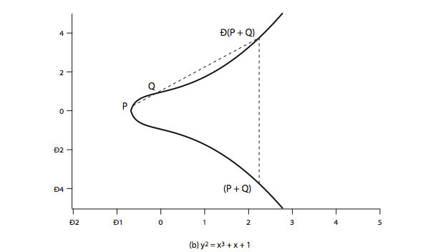
Example

Slide 5
Operation for elliptic curve
Geometrically Q+R is reflection of intersection of Q and R

Slide 6
Discrete Logarithm Problem on EC
Given an Integer k and a point P, on the computing kP is easy .
Can be done using repeated addition, takes only O(log k).

Slide 7
Discrete Logarithm Problem on EC
Given an Integer k and a point P, on the computing kP is easy .
But given kP and P, computing P is Hard.
In general only exponential time algorithms are known .

Slide 8
How is it used in Cryptography
Public key crypto systems
Alice and Bob has a pair of keys.
When Alice wants to send a message
Encryption (message, public key of Bob)
Decryption (message, private key of Bob)

Slide 9
How is it used in Cryptography
Users select an elliptic curve and a point G of large order, say n.
Alice chooses a large integer A (<n) which is her secret key and public key is AG.

Slide 10
How is it used in Cryptography
Alice chooses a large integer A (<n) which is her secret key and public key is AG.
To send a message, M to Alice
Send (KG, M+ KAG)

Slide 11
How is it used in Cryptography
Alice chooses a large integer A (<n) which is her secret key and public key is AG.
To send a message, M to Alice
Send (KG, M+ KAG)
Alice Computes M+KAG-A(KG)=M

Slide 12
ECC Security
Sub-exponential algorithms are known for factorizing Integers and solving discrete logarithmic problems over finite fields.
In general, only exponential algorithms are known for ECDLP

Slide 13
ECC Security
In general, only exponential algorithms are known for ECDLP
Compared to RSA, can use much smaller keys.
hence for similar security ECC offers significant computational

Slide 14
Comparable Key Sizes for Equivalent Security
Symmetric scheme (key size in bits) | ECC-based scheme (size of n in bits) | RSA/DSA (modulus size in bits)
56 | 112 | 512
80 | 160 | 1024
112 | 224 | 2048
128 | 256 | 3072
192 | 384 | 7680
256 | 512 | 15360

